Slide 1

Demand
1.1.3 Demand, Supply and Market Equilibrium

Slide 2

Learning objectives
Definition of demand.
The use of demand curve diagram to show:
changes in price causing movements along a demand curve
shifts indicating increased and decreased demand.
Factors that may cause a shift in the demand curve.
Today you will learn…

Slide 3

Demand activity
What is demand?
Demand definition:
The willingness and ability of consumers to buy a good or service at a given price in a given time period.
Complete the following Google Form

Slide 4
Demand activity
What is demand?
Demand definition:
The willingness and ability of consumers to buy a good or service at a given price in a given time period.

Slide 5
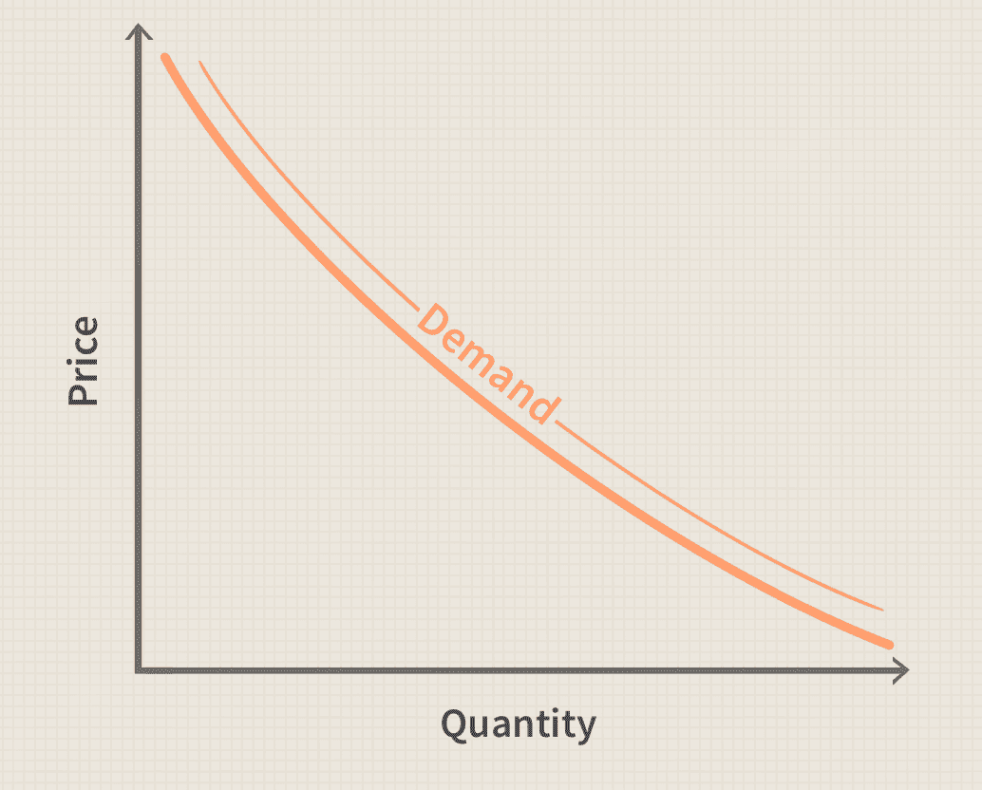
The Law of Demand
As the price of a product decreases the quantity demanded _________________
As the price of a product increases the quantity demanded _________________
It shows an inverse relationship between price and output (Normal Goods)
Inverse relationship means as one increases ⬆️ the other decreases ⬇️

Slide 6
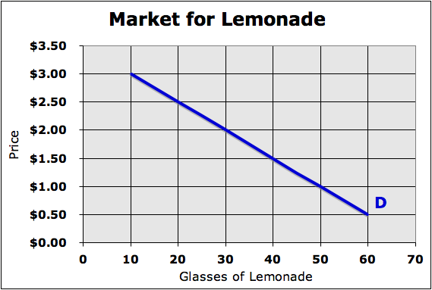
Demand can change in 2 ways
Change in “Quantity Demanded”
Movement along the demand curve
Notice how the blue demand line did not move. Just price changed, so we moved from one “quantity” to another.
Change in “Demand”
This is a shift of the entire demand curve either “left” or “right.”
Notice how the new blue demand line shows that more lemonade will be demanded at every price.
D₂

Slide 7
Drawing the graph
QUIZ
Increase in demand
Rightward shift
Right = increase
Decrease in demand
Leftward shift
Left = decrease
D₂
D₂

Slide 8
Increases Demand
There are six factors that will cause demand to increase.
Notes:
‹#›

Slide 9
Increase in demand - 6 Determinants of Demand
1) Consumers enter the market
MOVERS
Examples include an increase in the birth rate, an influx of immigrants, or students arriving in a college town.
Notes:
‹#›

Slide 10
Increase in demand - 6 Determinants of Demand
1) Consumers enter the market
2) Consumers have more money
$
Whenever people have more money (raise, tax refund, etc.), they are willing and able to spend it on more things.
Notes:
‹#›
This factor only holds true for normal goods. For inferior goods consumers will actually purchase less as they get more money.

Slide 11
Increase in demand - 6 Determinants of Demand
1) Consumers enter the market
2) Consumers have more money
3) Consumers expect good things to happen in the future
If consumers think they will have more money in the future or that the economy will grow (along with prices), they will purchase now.
Notes:
‹#›
This factor is not always an absolute case. Sometimes a good thing in the future (like a holiday purchasing season and all of its sales) will cause demand to actually decrease in the present moment.

Slide 12
Increase in demand - 6 Determinants of Demand
1) Consumers enter the market
2) Consumers have more money
3) Consumers expect good things to happen in the future
4) Product is a fad (popular)
Tickle Me Elmo
Items may become more popular due to a shift in tastes. This may happen because of fads, beliefs, culture, or advertising.
Notes:
‹#›

Slide 13
Increase in demand - 6 Determinants of Demand
1) Consumers enter the market
2) Consumers have more money
3) Consumers expect good things to happen in the future
Soda
4) Product is a fad (popular)
L
E
MONa
D
S
o
d
A
e
5) Price of a substitute good increases
$
1.
00
$
1.
00
$
2.
00
If an item that serves a similar function (substitute) becomes expensive, consumers will demand more of the original item.
Notes:
‹#›

Slide 14
Increase in demand - 6 Determinants of Demand
1) Consumers enter the market
2) Consumers have more money
3) Consumers expect good things to happen in the future
4) Product is a fad (popular)
L
E
MONa
D
Cup
ca
ke
s
e
$
1.
00
$
4.
00
$
2.
00
5) Price of a substitute good increases
When goods are consumed together (complements), a decrease in the price of one makes both more appealing.
6) Price of a complementary good decreases
Notes:
‹#›

Slide 15
Decreases Demand
There are six factors that will cause demand to decrease.
Notes:
‹#›

Slide 16
Decrease in demand - 6 Determinants of Demand
1) Consumers leave the market
MOVERS
MOVERS
Examples include a decrease in the birth rate, people moving away, or students leaving a college town for the summer.
Notes:
‹#›

Slide 17
Decrease in demand - 6 Determinants of Demand
1) Consumers leave the market
2) Consumers have less money
$
Consumers will obviously not be able to buy as much if less money is available. This can be caused by unemployment, taxes, etc.
Notes:
‹#›
This factor only holds true for normal goods. For inferior goods consumers will actually purchase more when they have less money.

Slide 18
Decrease in demand - 6 Determinants of Demand
1) Consumers leave the market
2) Consumers have less money
3) Consumers expect bad things to happen in the future
If consumers think they will have less money in the future or that the economy will shrink (along with prices), they will purchase later.
Notes:
‹#›
This factor is not always an absolute case. Sometimes a bad thing in the future (like significantly higher taxes in the next year) will cause demand to actually increase in the present moment.

Slide 19
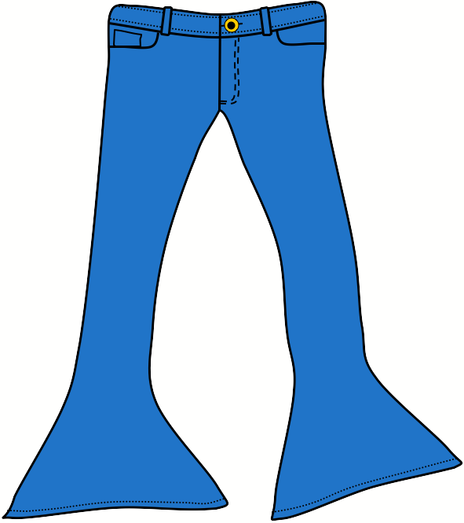
Decrease in demand - 6 Determinants of Demand
1) Consumers leave the market
2) Consumers have less money
3) Consumers expect bad things to happen in the future
4) Product goes out of style
Items may become less popular due to a shift in tastes. Products that were once in style may suddenly become out of favor.
Notes:
‹#›

Slide 20
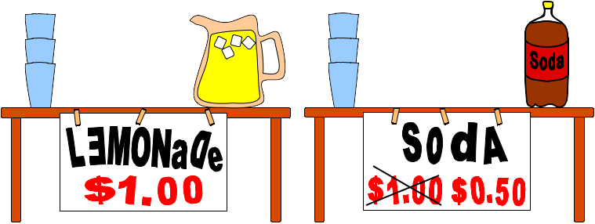
Decrease in demand - 6 Determinants of Demand
1) Consumers leave the market
2) Consumers have less money
3) Consumers expect bad things to happen in the future
4) Product goes out of style
5) Price of a substitute good decreases
If an item that serves a similar function (substitute) becomes inexpensive, consumers will switch their demand to the substitute.
Notes:
‹#›

Slide 21
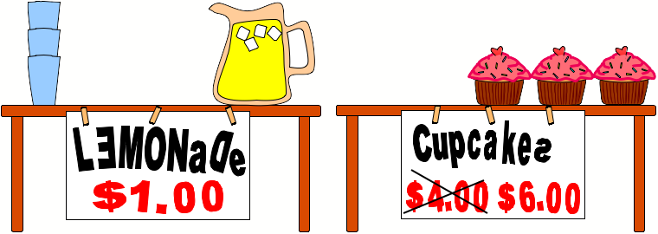
Decrease in demand - 6 Determinants of Demand
1) Consumers leave the market
2) Consumers have less money
3) Consumers expect bad things to happen in the future
4) Product goes out of style
5) Price of a substitute good decreases
When goods are consumed together (complements), an increase in the price of one makes both less appealing.
6) Price of a complementary good increases
Notes:
‹#›

